Slide 1
Space Race
Dhruvika Rajpara

Slide 2
agenda
EXECUTIVE SUMMARY
INTRODUCTION
METHODOLOGIES
RESULT
CONCLUSION

Slide 3
Executive Summary
Summary of Methodologies
Data Collection
Data Wrangling and Analysis
Interactive Maps
Summary of All Result
Data Analysis and Visualization -> Best model?

Slide 4

Introduction
Project background and context:
Will SpaceX rocket Falcon 9 will land successfully?
Note: SpaceX reuses of the first stage of the rocket
Natural questions we want to find answers:
Which factors influence the landing?
-> Its precise impact?
=> What are the best conditions for best results?

Slide 5
Methodologies
Section - 1

Slide 6
Methodologies
Data collection methodology:
-> SpaceX API, Wikipedia
Perform data wrangling:
-> One hot encoding, drop irrelevant (i.e. uncorrelated) columns
Perform exploratory data analysis (EDA) using visualization and SQL:
-> Scatter/Bar/Pie charts for visual pattern recognition
Perform interactive visual analytics using Folium and Plotly Dash:
-> Via Folium and Plotly Dash
Perform predictive analysis using classification models:
-> Using Regression and Tree techniques

Slide 7
Data Collection
What is to do?
-> Gather and measure information on targeted variables
Pipeline:
Data from API/Wikipedia .
Optional: Export data as(.csv-)file
Transform data
into table/ data frame

Slide 8
Data Collection – SpaceX API pipeline
Establish connection to SpaceX-API via requests
Transform data(.json) into table/dataframe
Clean/Filter dataframe
(Optional)Export to (.csv) file

Slide 9
Data Collection – Webscraping pipeline
Establish HTML connection
Create BeautifulSoup Object
Filter for table
Get their column names and append data
Conversion to dataframe
Optional: Export to (.csv) file

Slide 10
Data Wrangling
What is to do?
->Cleaning and polishing possible messy/complex data sets for better handling
Pipeline:
Load data as dataframe
Cleaning data
Simplify to Boolean values
Optional: Export data as file

Slide 11
EDA with Data Visualization
What is to do?
-> Create visuals and collection optical insights
Here:
- Payload mass/Flight number vs Launch site/Orbit type/Flight number as scatterplot for type of dependency
- Success rate vs orbit type as bar chart for impact of variable
- Launch Success vs Year for trend observation

Slide 12
timeline
NOV 20XX
disseminate standardized metrics
SEP 20XX
synergize scalable e-commerce
JAN 20XX
coordinate e-business applications
MAR 20XX
foster holistically superior methodologies
MAY 20XX
deploy strategic networks with compelling e-business needs

Slide 13
EDA with SQL
What is to do?
Heuristically guessing/querying/questioning in the database what might have happened
We have questioned as follows:
General overview over available landsides, in particular whose five entries who start with 'CCA’
Number of successful/failed mission outcome
List for failed ones in 2015
List first successful landing outcome in drone ship
Specify, count and rank outcomes between ~2010 and ~2017
Average Payload per booster version 'F9v1.1'/Total for boosters carried by NASA (CRS)
Booster version with maximal payload
Names of boosters with successful ground pad and certain payload

Slide 14

Build a Dashboard with Plotly Dash
What has been done?
Selection of Launch Site
Pie charts for relation percentage based on launch site
Scatter graphs for correlation between payload and success based on launch site
Why?
-> To visualize the effectiveness of the launch site and payload mass

Slide 15
Predictive Analysis (Classification)
Building
Evaluation and Improvement
Conclusion
Standardize/transform data
Split into test/training sets
Using training set initialize different ML algorithm
Check for accuracy via - R-score - Confusion matrix (true/false vs land./not land.)
=> Search for best
-> Score
-> Parameters for ML
Depending on accuary: Choose best model!

Slide 16
Results
Exploratory data analysis results
Interactive analytics demo in screenshots
Predictive analysis results

Slide 17
Insights drawn from EDA
Section - 2

Slide 18
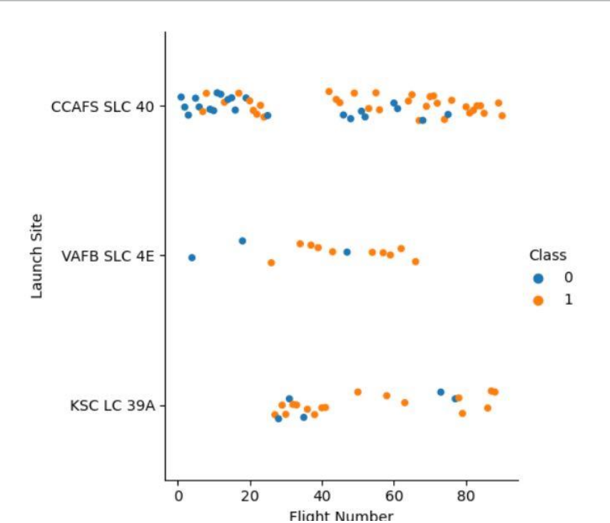
Flight Number vs. Launch Site
First ~25 Starts, in particular. at CCAFS SLC 40 were mostly failures
Starts at KSC LC 39A gave them then information for success
VAFB SLC 4E with most successful launches (relatively)

Slide 19
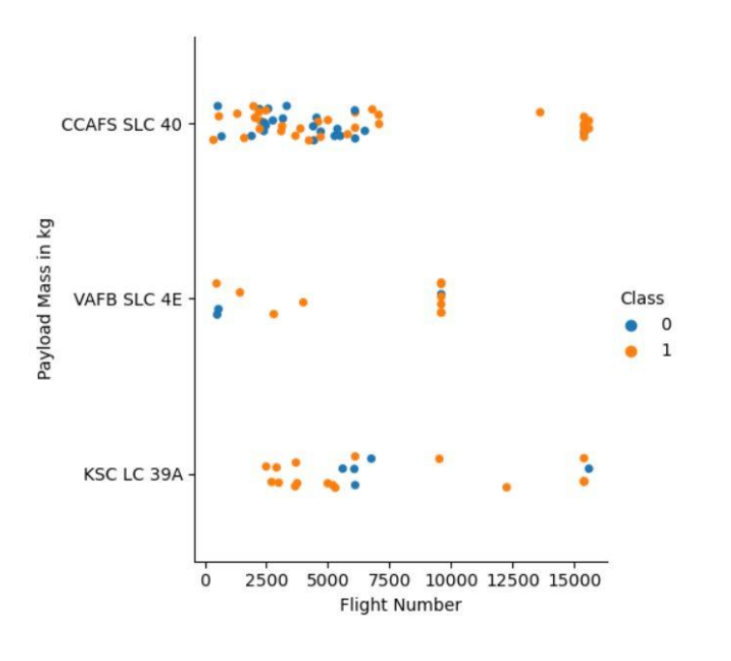
Payload vs. Launch Site
After successfully establish a launch with low mass ~7500kg,
Launches with higher payload masses were almost always successful

Slide 20
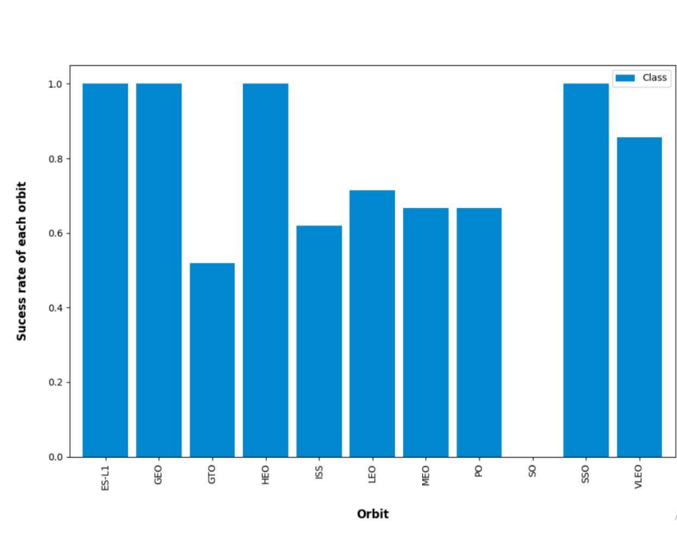
Success Rate vs. Orbit Type
Launches onto SO were disastrous (only one launch)
ES -L1, GEO, HEO and SSO with success only

Slide 21
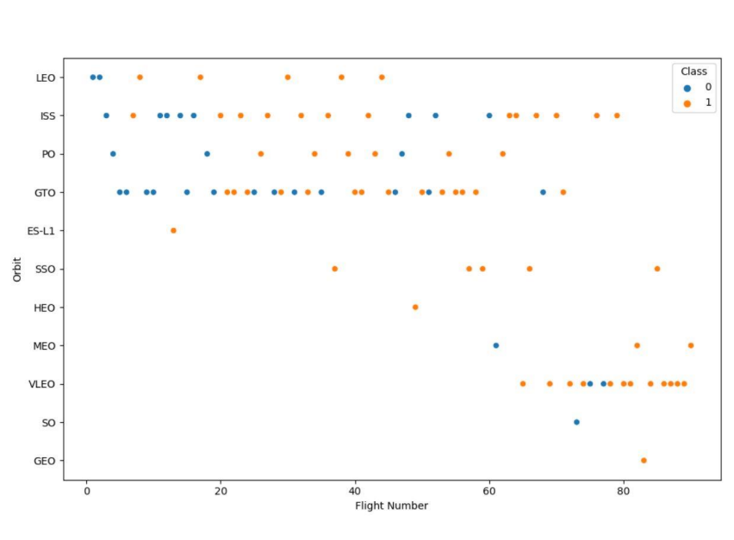
Flight Number vs. Orbit Type
At the beginning, testing on four selected orbits
ISS and GTO gave them a breakthrough after flight number ~ 20
After flight number ~ 60 also focused on other orbits, in particular on VLEO

Slide 22
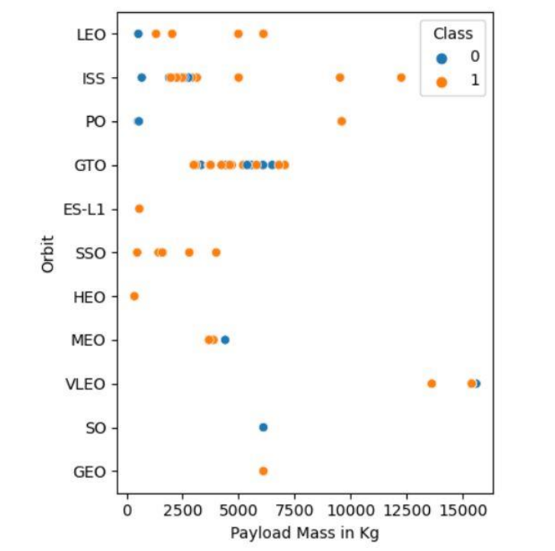
Payload vs. Orbit Type
Started mostly with ~2500 - 7500kg
Launches with higher payload > 7500kg rather successful

Slide 23
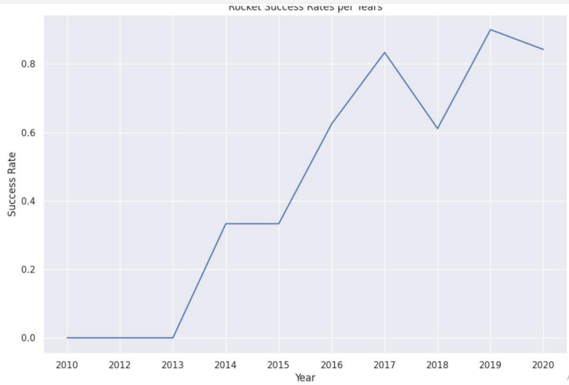
Launch Success Yearly Trend
Since 2013 mostly improving
Since 2017 mostly >80% except for
Dip in Success in 2018

Slide 24
EDA with SQL

Slide 25
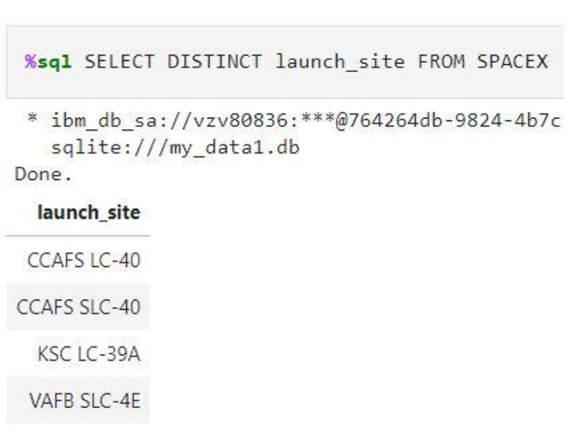
All Launch Site Names
Find the names of the unique launch sites
Key word DISTINCT does the job

Slide 26
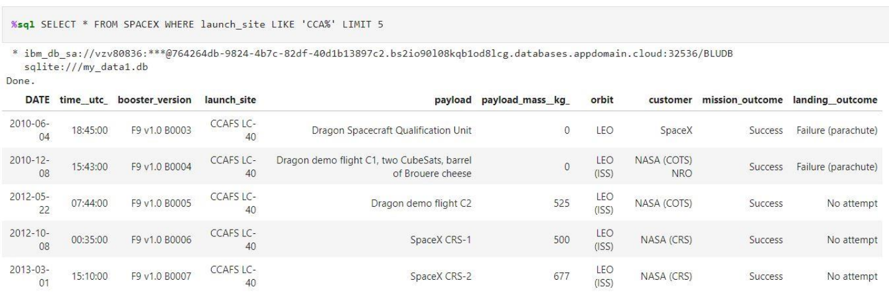
Launch Site Names Begin with 'CCA'
Find 5 records where launch sites begin with ‘CCA’
Make use of the WHERE keyword for the condition and use % as a wildcard for an arbitrary ending

Slide 27
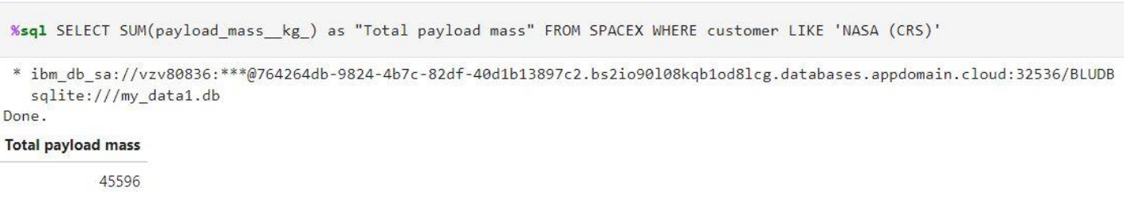
Total Payload Mass
Calculate the total payload carried by boosters from NASA
Use the function SUM to create a new column and thus, the total payload

Slide 28
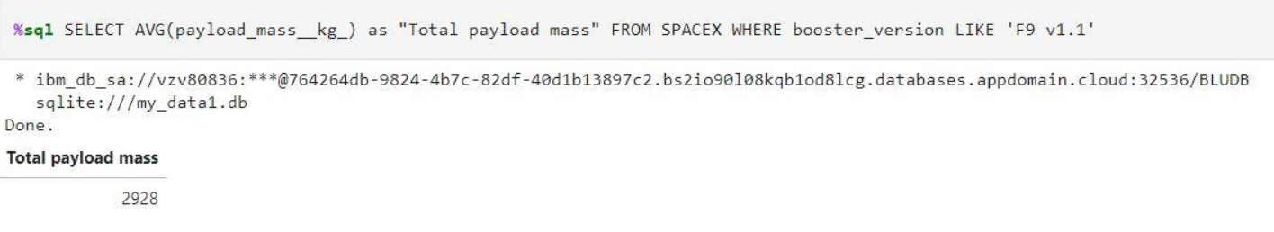
Average Payload Mass by F9 v1.1
Calculate the average payload mass carried by booster version F9 v1.1
Use the function AVG to create a new column and thus, the desired average

Slide 29
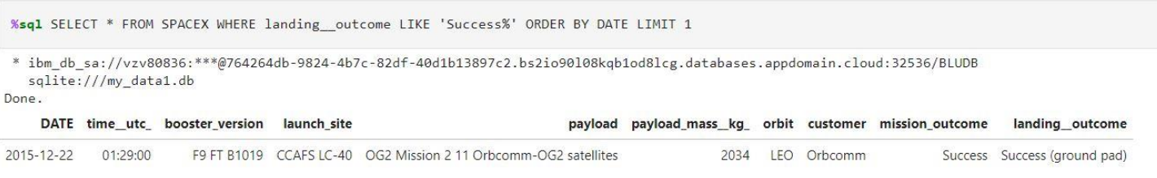
First Successful Ground Landing Date
Find the dates of the first successful landing outcome on a ground pad
Use ORDER to get a descending sequence of dates and therefore, the first entry gives the desired result, implemented via LIMIT 1

Slide 30
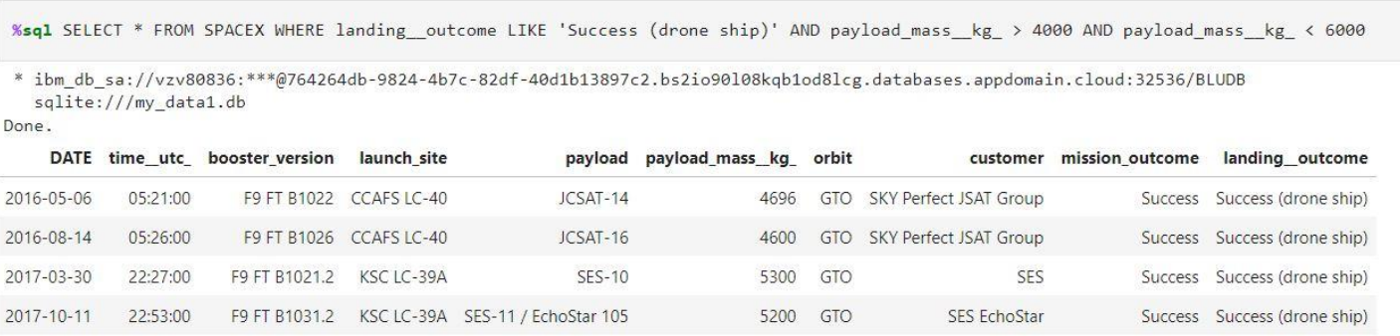
Successful Drone Ship Landing with Payload between 4000 and 6000
List the names of boosters which have successfully landed on drone ship and had payload mass greater than 4000 but less than 6000
A combination of two conditions in the WHERE clause is realized via the AND keyword

Slide 31
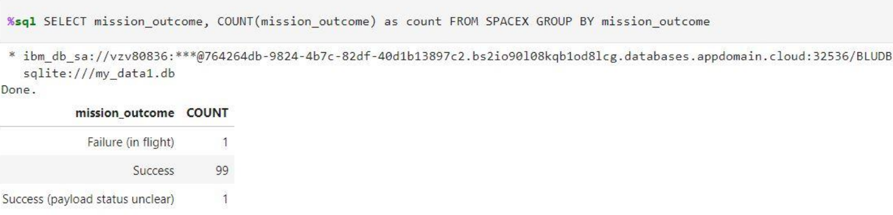
Total Number of Successful and Failure Mission Outcomes
Calculate the total number of successful and failure mission outcomes
Using the function COUNT one can count the amount of entries But, we would like to do so with a grouping of result which is done via the GROUP BY keyword

Slide 32
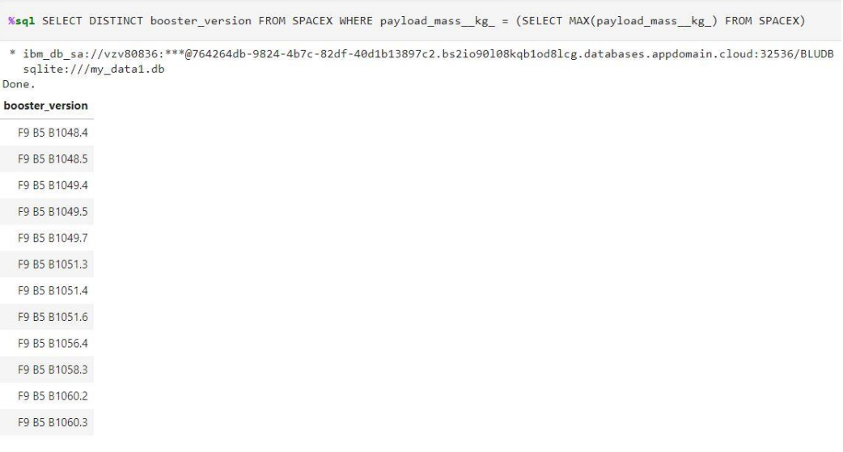
Boosters Carried Maximum Payload
List the names of the booster which have carried the maximum payload mass
Used a second query to find the maximal payload in which we used the MAX function. With this information, we can employ it in the condition part.

Slide 33
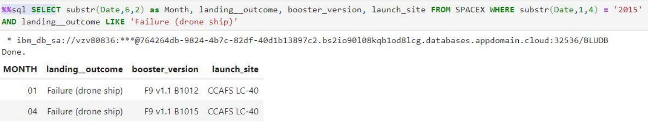
2015 Launch Records
List the failed landing_outcomes in drone ship, their booster versions, and launch site names for in year 2015
Here we use a specialty of SQLite, the substr function, i.e. it gives a substring based on an index and some length. We apply it on the date variable to extract year and month

Slide 34
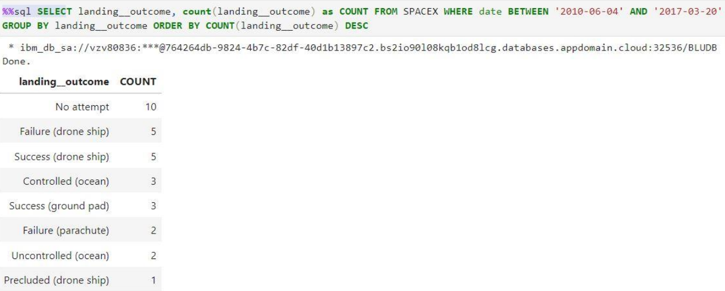
Rank Landing Outcomes Between 2010-06-04 and 2017-03-20
Rank the count of landing outcomes (such as Failure (drone ship) or Success (ground pad)) between the date 2010-06-04 and 2017-03- 20, in descending order
Used the DESC keyword to get a descending list which is ordered by the amount of landing outcomes while satisfying all other conditions

Slide 35
Launch Sites Proximities Analysis
Section - 3

Slide 36
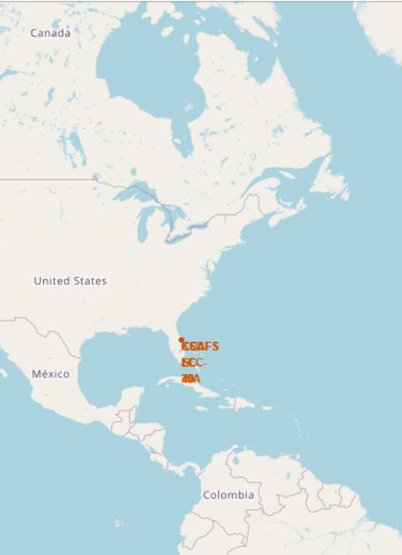
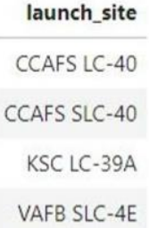
Launch Sites on Map
• Launch Sites are located on the east and west coast of the US
-> precisely in California and Florida

Slide 37
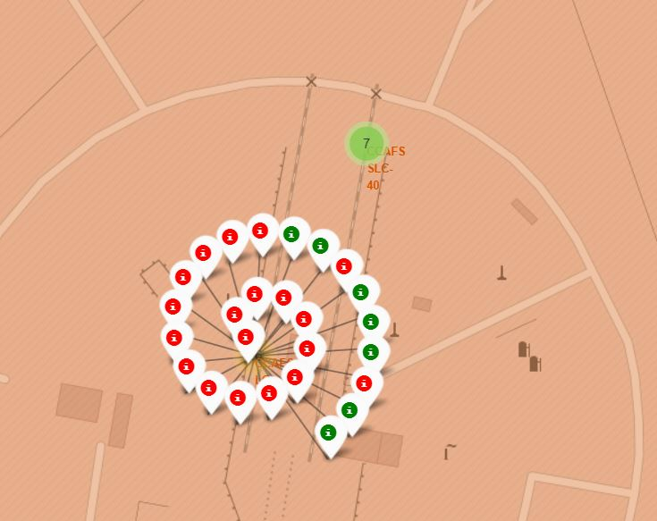
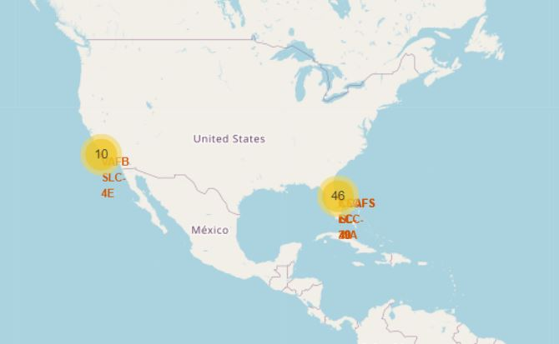
Success on Launch Site
Added Markers to indicate success and failure at each launch site.
Due to their size they are summarized in larger zooming views

Slide 38
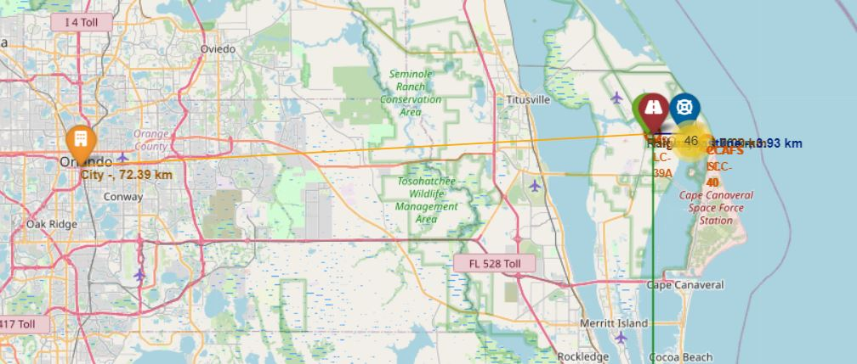
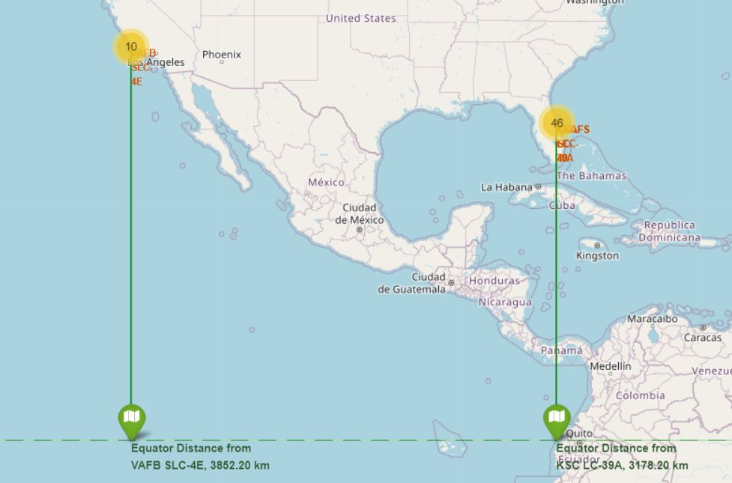
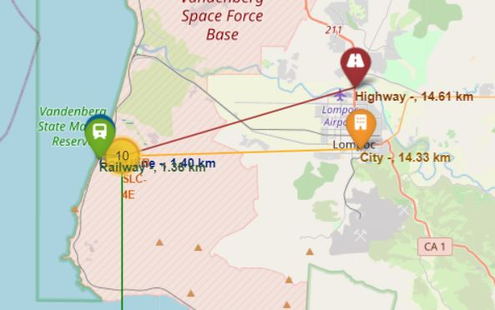
Distances from launch sites to equator and environment
Launch Sites are directly at the coasts but ~ 10-15km away from the next big city and next highway, safe enough in case of an accident
Roughly 3000-4000km from the equator where the highest earth rotational speed of the earth is and thus, better launch conditions

Slide 39
Build a Dashboard with Plotly Dash
Section - 4

Slide 40
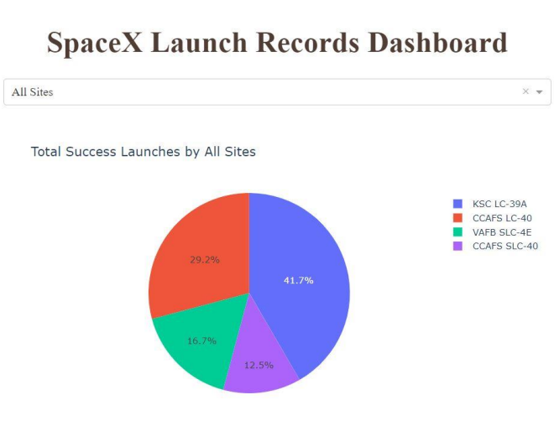
Launch Success: All Sites
KSC-LC-39A has highest share of success
CCAFS.SLC-40 has lowest share of success

Slide 41
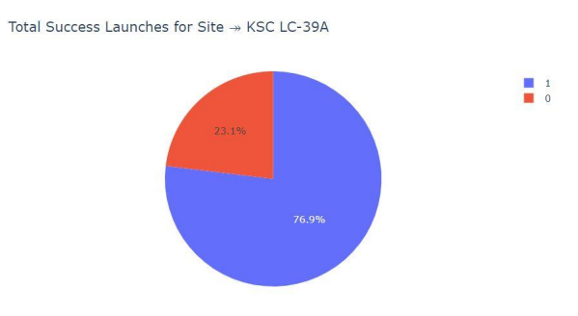
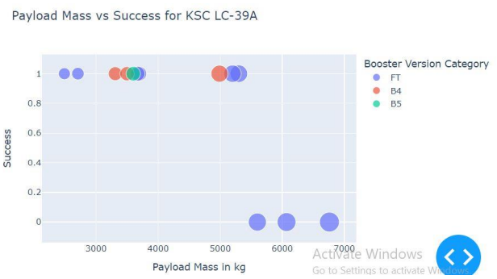
KSC-LC-39A in Detail
~¾ Success rate
Mixed success for FT boosters while overall best
But, B4 and B5 version categories doing well

Slide 42
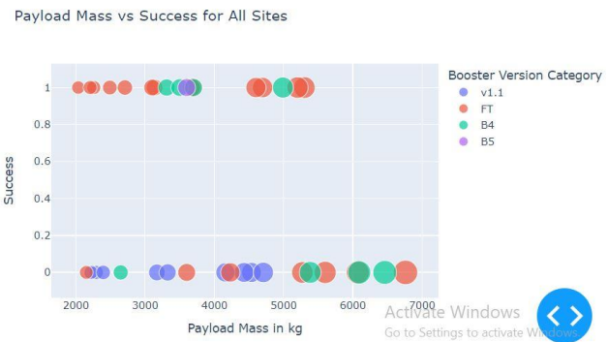
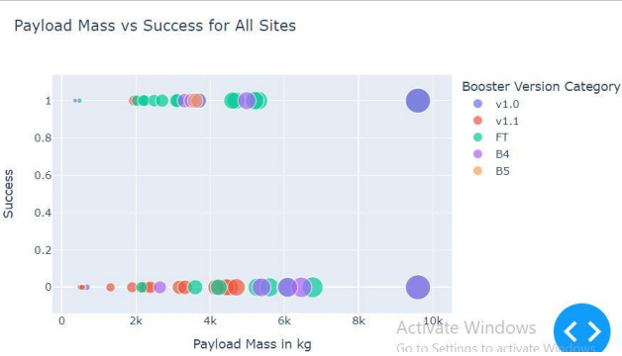
Payload vs Launch Outcome
Generally, Booster category FT does well for lower payload masses
For >5000kg rather failure
For mid-size payloads (2k-7k) booster version v1.1 is miserable

Slide 43
Predictive Analysis (Classification)
Section - 5

Slide 44
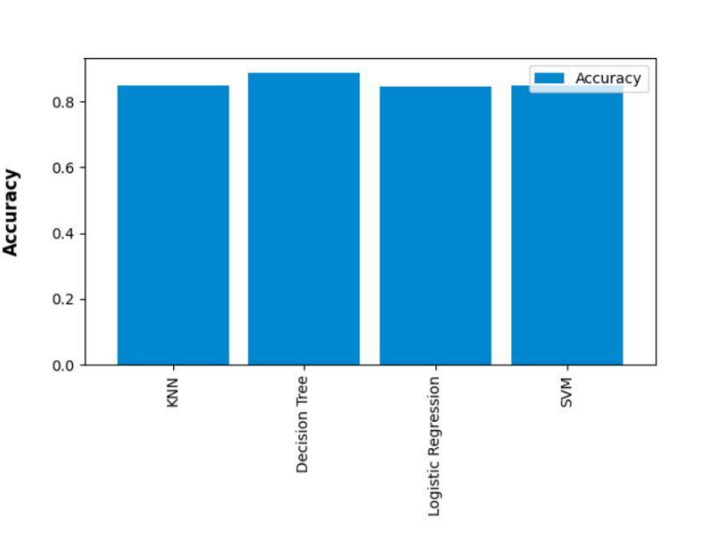
Classification Accuracy
Decision Tree Model is the best with an accuracy with arround 91%
Others perform only minorly worse with accuracy rates > 84%

Slide 45
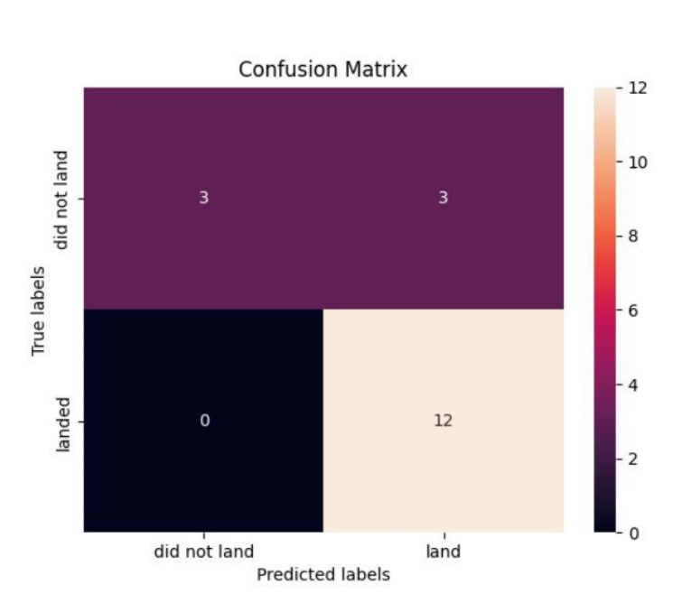
Confusion Matrix for Decision Tree
True/false vs Land/Not Land Matrix
Predicted landing outcomes for the test data=subset of original data
Unfortunately, we have True/Not -Land outcomes
But, overall 15/18 correct predictions

Slide 46
Conclusions

Slide 47
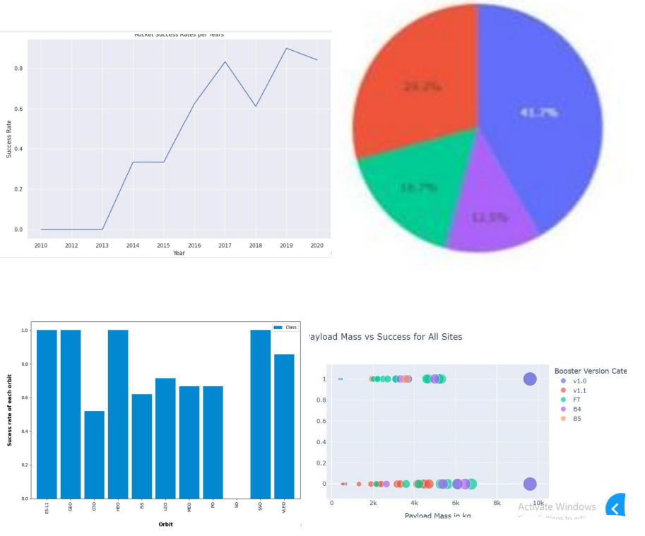
Conclusions
Orbits ES-L1, GEO, HEO, SSO have highest success rates
Success rate for launches increased over time
KSC LC -39A had the most successful launches
For higher payloads (>5000kg) rather failure
Decision Tree is the best predictive Model

Slide 48
Thank You
Dhruvika Rajpara

